Slide 1
Building a Highly Available Scalable Web Application
Project Report
Mohammed Ibrahim Hamissa AWS Cloud Solutions Admin and Architect ALX1-ISS4-M1e October, 2024

Slide 2
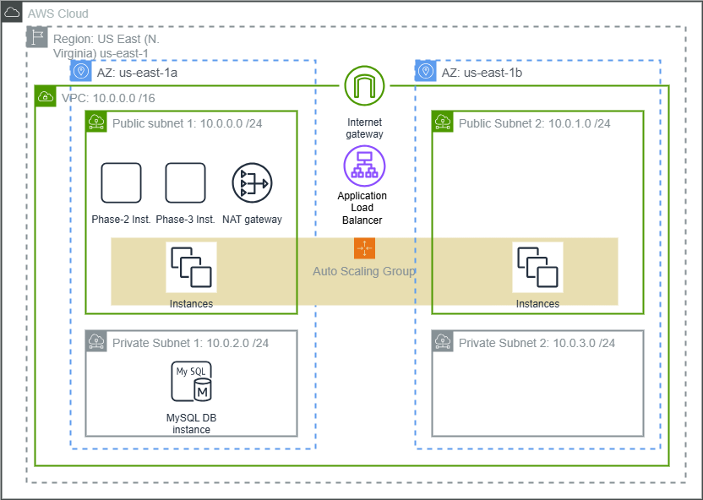
Architectural Diagram

Slide 3
VPC
Region
US East (N. Virginia) us-east-1
VPC
Name tag – optional: Web Lab VPC
IPv4 CIDR: 10.0.0.0 /16

Slide 4
VPC
Public Subnet1
10.0.0.0/24
Public Subnet2
10.0.1.0/24
Private Subnet1
10.0.2.0/24
Private Subnet2
10.0.3.0/24

Slide 5
VPC
Internet Gateway
Web Lab IGW
NAT Gateway Name groupNATgateway
Public Subnet1

Slide 6
VPC
Private Route Table
Routes locally within the VPC, and into NAT gateway
Private Subnet1, Private Subnet2
Public Route Table
Web Lab Public RT
Routes to Web Lab IGW
Public Subnet1, Public Subnet2

Slide 7
EC2
Phase2Inst
Public Subnet1
Web APP SG
UserdataScript-phase-2.sh
Phase3Inst
Public Subnet1
Web APP SG
UserdataScript-phase-3.sh

Slide 8
VPC
Web APP SG
Allows HTTP and SSH traffic to web servers
DB SG
Permits access to DB from web APP SG and AuSC SG
LoadBalancer SG
Accepts HTTP traffic
AuSC SG
Accepts traffic from LoadBalancer SG

Slide 9
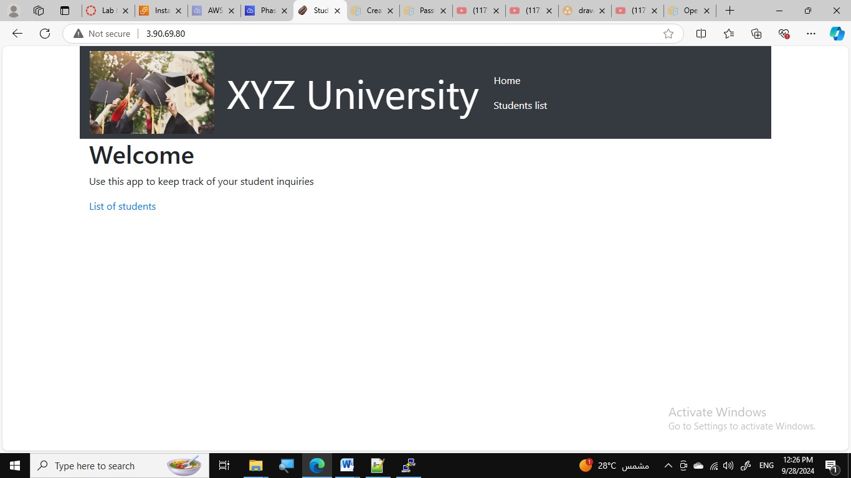
Phase2Inst and Phase3Inst created and tested

Slide 10
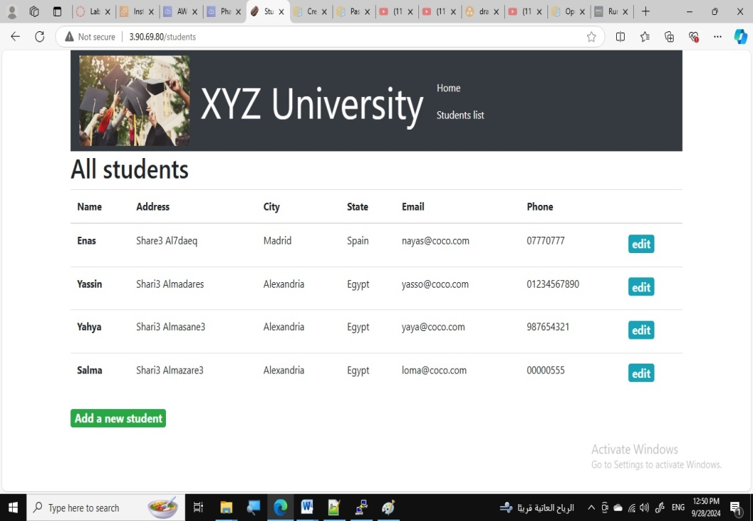
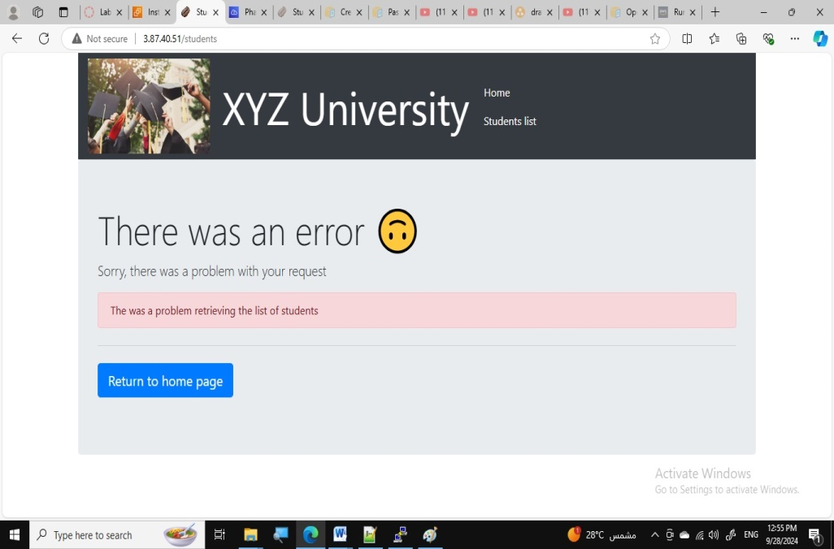
Phase2Inst and Phase3Inst created and tested
Phase3Inst response is shown as no RDS instance has been created yet
Local database populted

Slide 11
RDS
DB Instance
web-lab-db
MySQL
us-east-1a
DB SG
db subnet group
Private Subnet1, Private Subnet2
Populated by a dump from Phase2Inst

Slide 12
Auto Scaling
Load Balancer WEB-APP-LB
Public Subnet1, Public
LoadBalancer SG
Target Group Web-App-Targets
Scaling Group Web-APP-ASG
Private Subnet1, Private Subnet2
Launch Template based on Phase3Inst

Slide 13
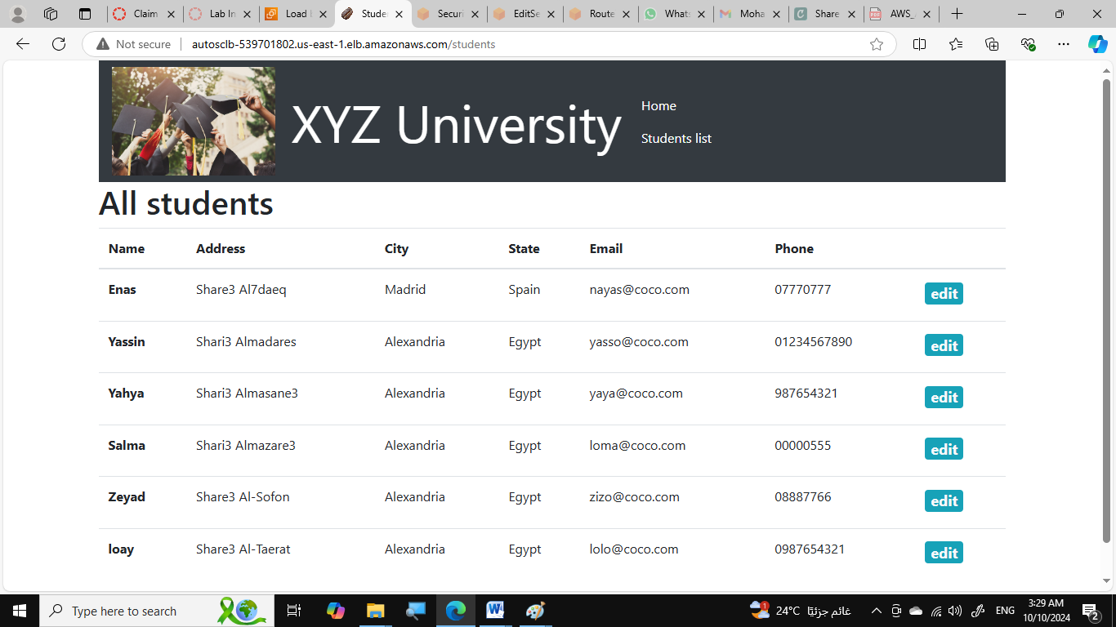
web-lab-db successfully accessed through LB
Data migrated to RDS can be accessed through load balancer’s DNS name

Slide 14
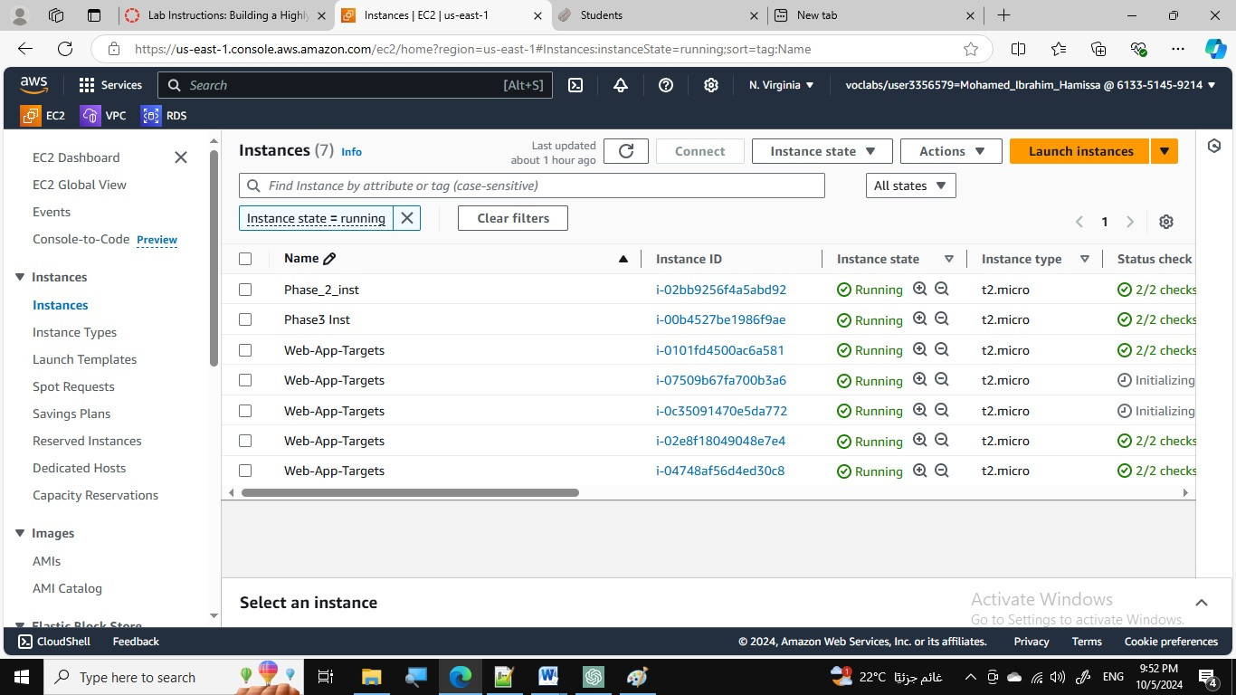
Loading test successfully performed
Through running script on Phase2Inst

Slide 15
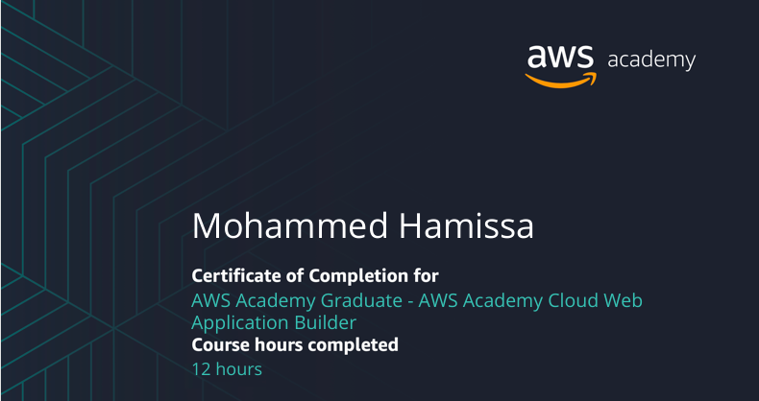
AWS Project: Securing Cloud Resources
Thanks Alot

